Slide 1
Model Serving Strategies

Slide 2
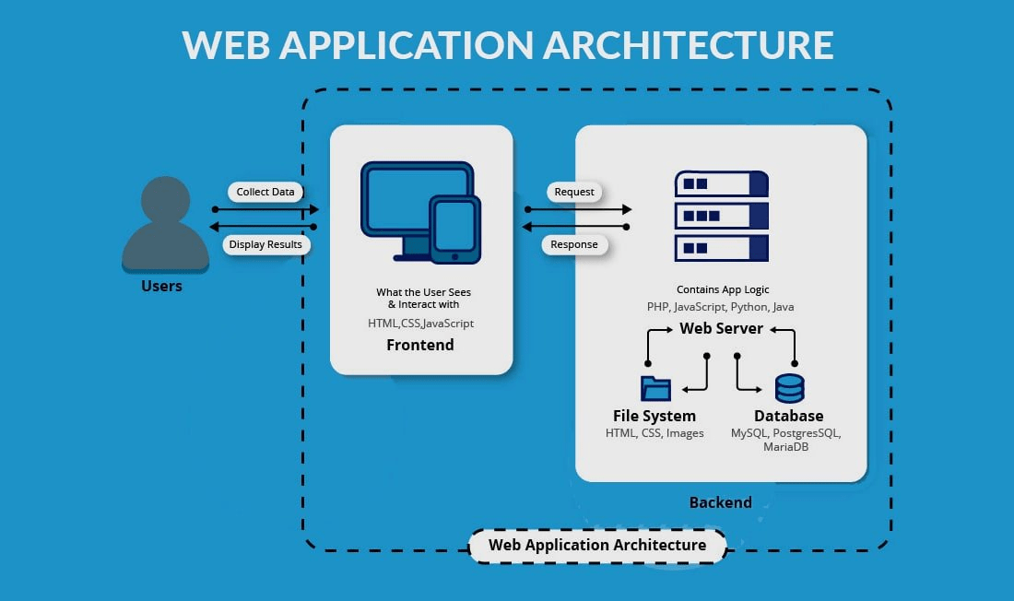
Web Application

Slide 3
Flask
Flask is a micro web framework written in Python.
This web app will be used to consume the created model.
For instance, a user can enter the feature values into the form and after submitting, the model will predict the outcome(churn or not).
Docs
Notes:
en este punto igual es necesario dibujar en la pizarra qué es un servidor web y request http post, get, ….

Slide 4
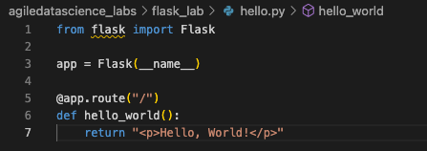
Flask 101
install Flask: pip install flask
create a hello.py file with
run the app in the server: flask --app hello run --port=5002

Slide 5
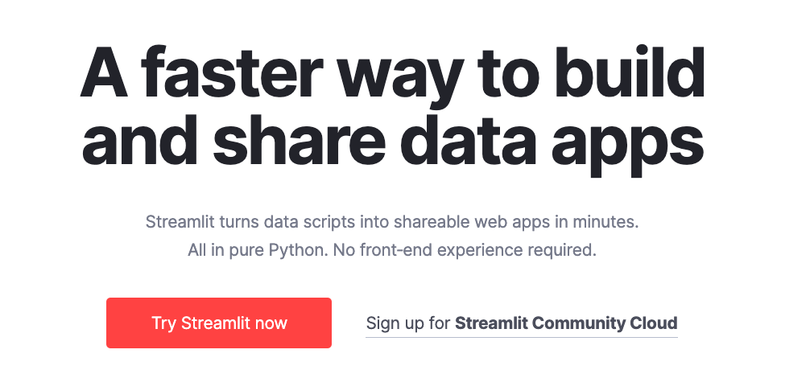
Streamlit - https://streamlit.io/
Docs

Slide 6
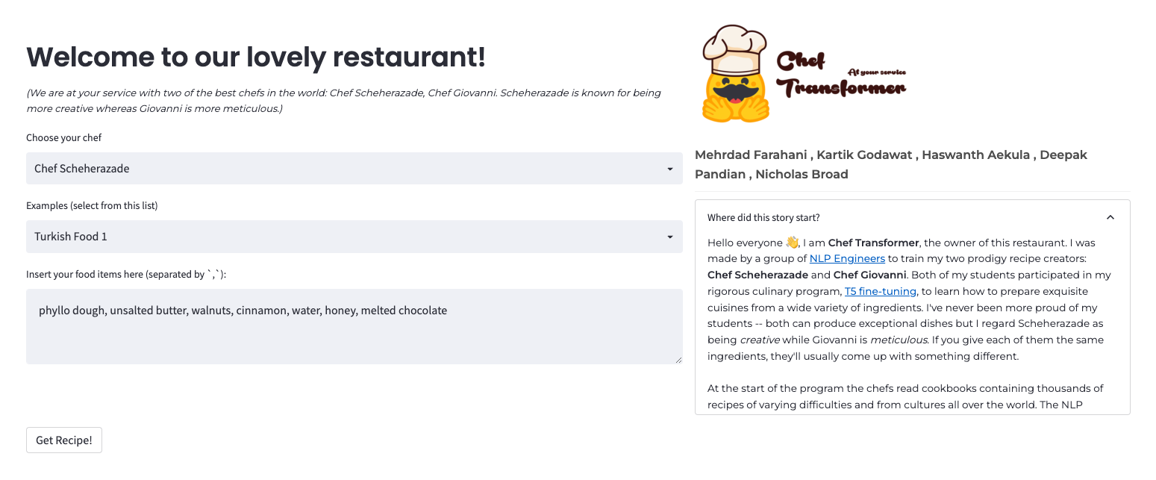
Streamlit - Chef Composer
Chef Transformer

Slide 7
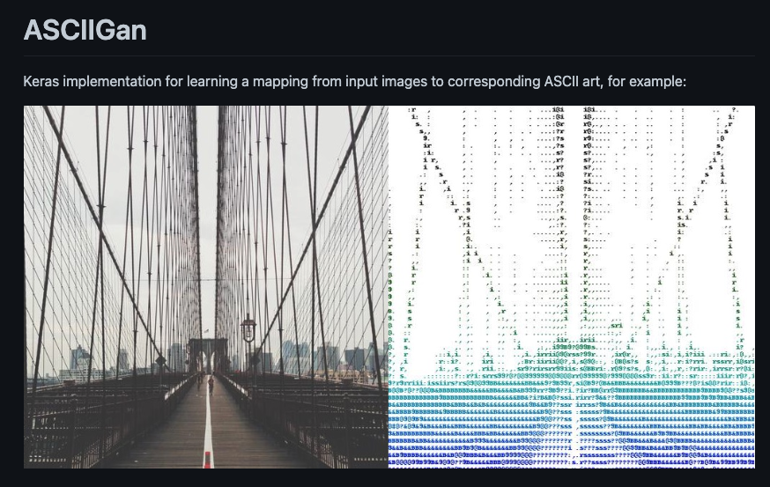
Streamlit - Pic2Ascii
Github
Notes:
demo: show the Google Collab
demo: show the Generating

Slide 8
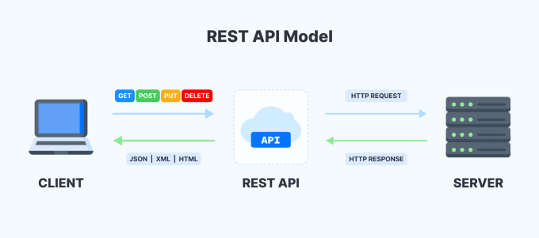
API REST

Slide 9
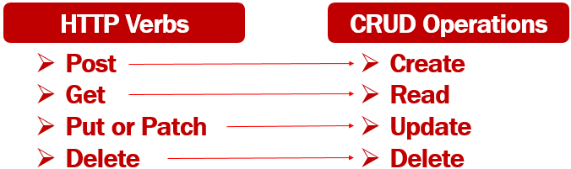
API REST

Slide 10
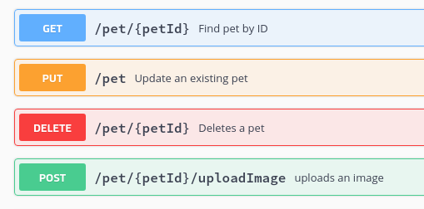
API REST

Slide 11
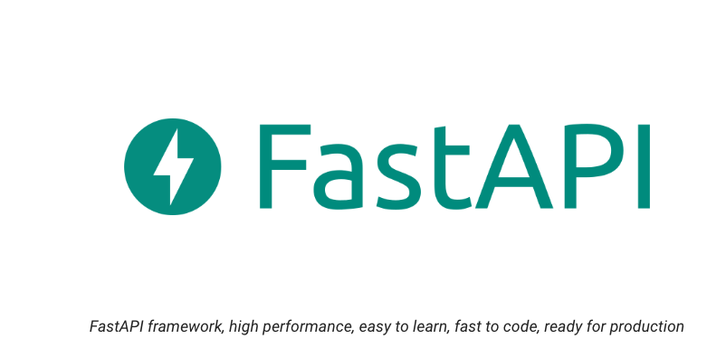
FAST API
Docs

Slide 12
FAST API - Example
go to fastapi-lab in the course github
install fastapi and uvicorn packages
train the model executing python model/train.py
run the API REST server with uvicorn app:app --reload under the project folder
review and test it in the Fast API docs: http://127.0.0.1:8000/docs

Slide 13
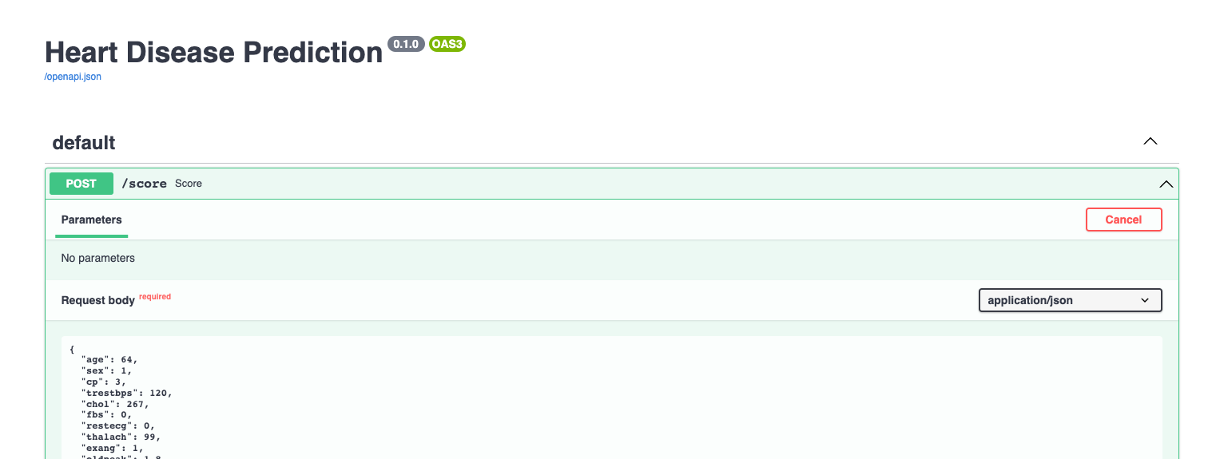
FAST API - Docker
Review the Dockerfile
run docker build -t fastapiml .
run docker run -d --name heart-disease-serving -p 80:80 fastapiml

Slide 14
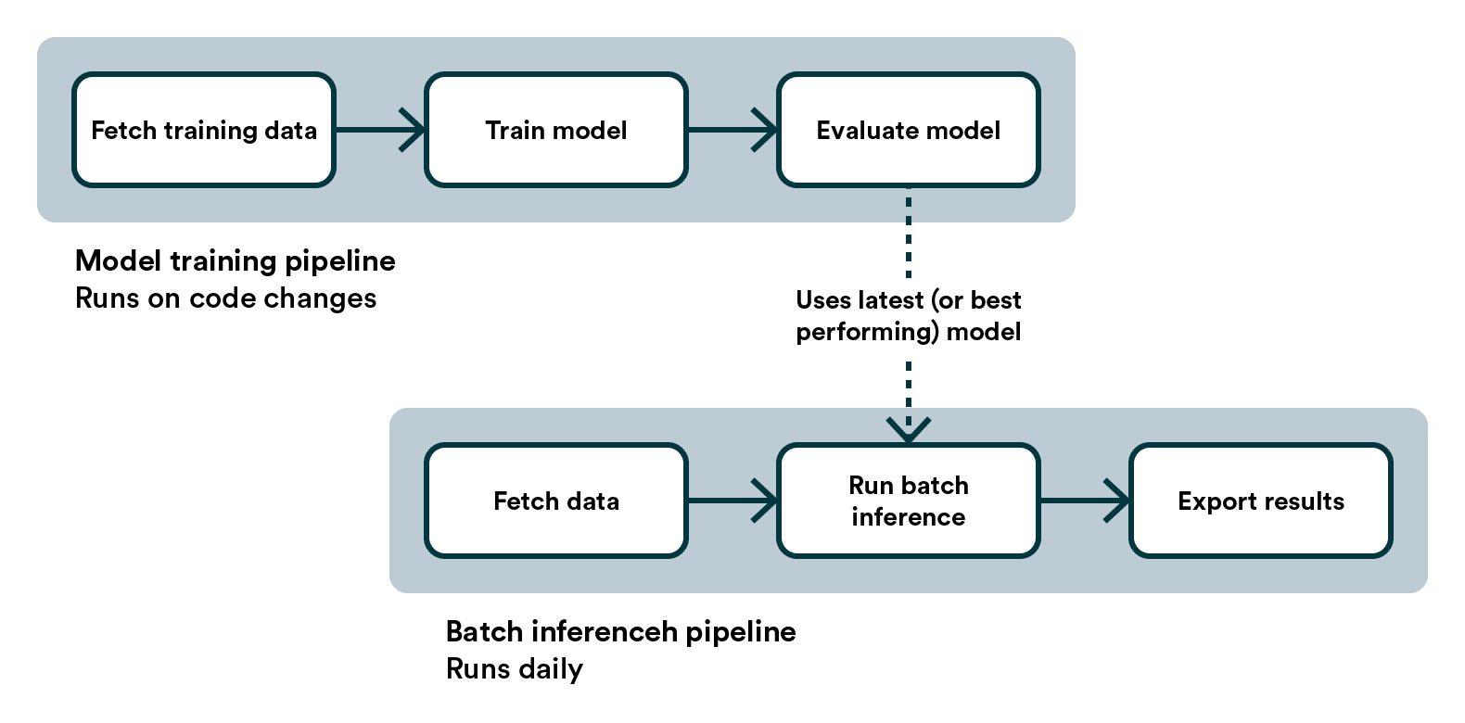
Batch inference

